Slide 1
Lecture 14

Slide 2
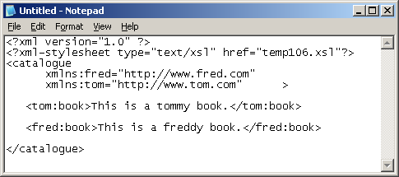
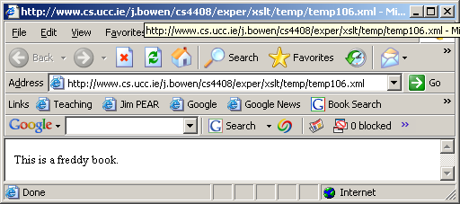
node-tests again: namespace-qualified node-tests
<?xml version="1.0"?>
<xsl:transform version="1.0" xmlns:xsl="http://www.w3.org/1999/XSL/Transform">
<xsl:template xmlns:fred="http://www.fred.com" match="/">
<body> <xsl:apply-templates select="./*/fred:*"/> </body>
</xsl:template>
<xsl:template match="book" >
<p> I found a book. </p>
</xsl:template>
</xsl:transform>
The fred:* node test admits only element in the fred namespace
The match="book" template processes only books in the default namespace, so it is not used to process books in the fred namespace
  so the matched book is given the default processing

Slide 3
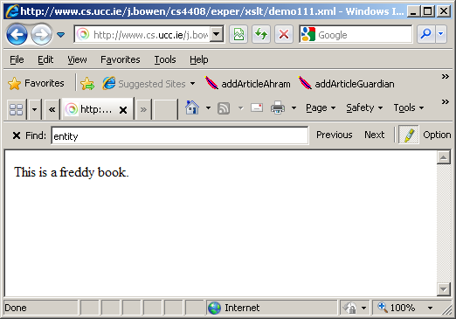
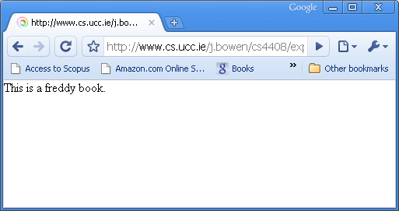
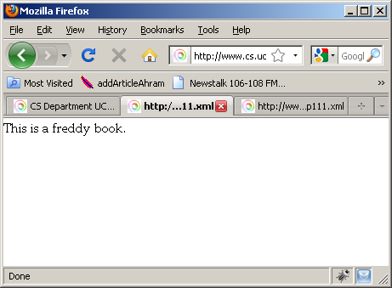
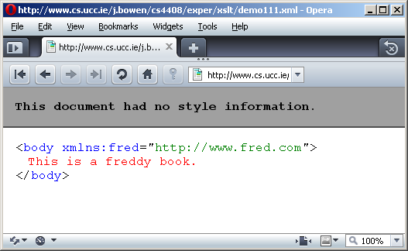
Various browsers treat the last example differently

Slide 4
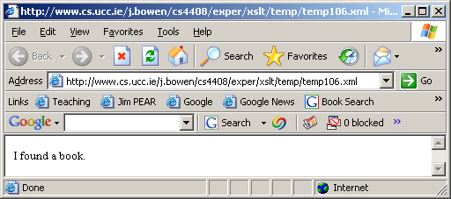
namespace-qualified node-tests (contd.)
<?xml version="1.0"?>
<xsl:transform version="1.0" xmlns:xsl="http://www.w3.org/1999/XSL/Transform">
<xsl:template xmlns:fred="http://www.fred.com" match="/">
<body> <xsl:apply-templates select="./*/fred:*"/> </body>
</xsl:template>
<xsl:template xmlns:fred="http://www.fred.com" match="fred:book" >
<p> I found a book. </p>
</xsl:template>
</xsl:transform>
The fred:* node test admits only element in the fred namespace
The match="fred:book" template processes the books in that namespace
  so the matched book is given the programmer-specified processing

Slide 5
Namespace-semantics: its the URIs that matter
<?xml version="1.0"?>
<xsl:transform version="1.0" xmlns:xsl="http://www.w3.org/1999/XSL/Transform">
<xsl:template xmlns:fred="http://www.fred.com" match="/">
<body> <xsl:apply-templates select="./*/fred:*"/> </body>
</xsl:template>
<xsl:template xmlns:bill="http://www.fred.com" match="bill:book" >
<p> I found a book. </p>
</xsl:template>
</xsl:transform>
The fred:* node test admits only element in the http://www.fred.com namespace
The match="bill:book" template processes the books in that same namespace
  because the bill: prefix and fred: prefix refer to the same URI

Slide 6
Predicates
An XPath expression selects a set of nodes in the Xpath tree
Often one needs to filter the node set, to select only some of the nodes returned by an expression:
  Each step in a location path may have a predicate that filters the node list at that step in the expression.
  The predicate contains a boolean expression, which is tested for each node in the context node list:
    If the predicate is true, the node is retained in the list
    If the predicate is false, that node is deleted from the list

Slide 7
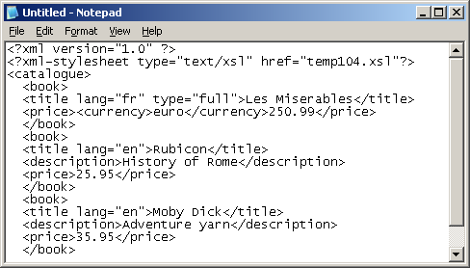
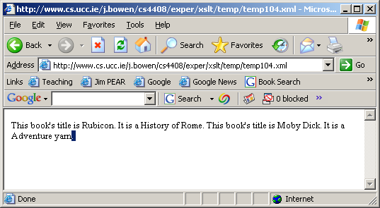
Selecting nodes with children of specific types
<?xml version="1.0"?>
<xsl:transform version="1.0" xmlns:xsl="http://www.w3.org/1999/XSL/Transform">
<xsl:template match="/">
<body> <xsl:apply-templates select="./catalogue/book[description]"/> </body>
</xsl:template>
<xsl:template match="book">
This book's title is <xsl:value-of select="./title"/>.
It is a <xsl:value-of select="./description"/>.
</xsl:template>
</xsl:transform>
Format: [ tagname ]

Slide 8
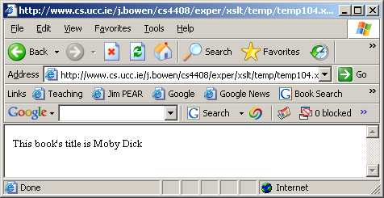
Selecting nodes with more-specific types of children
<?xml version="1.0"?>
<xsl:transform version="1.0" xmlns:xsl="http://www.w3.org/1999/XSL/Transform">
<xsl:template match="/">
<body> <xsl:apply-templates select="./catalogue/book[price>30]"/> </body>
</xsl:template>
<xsl:template match="book">
This book's title is <xsl:value-of select="./title"/>.
</xsl:template>
</xsl:transform>
Format: [ tagname comparator value ]

Slide 9
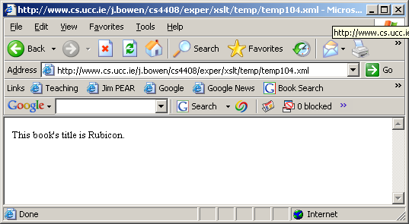
Take care with comparison operators
<?xml version="1.0"?>
<xsl:transform version="1.0" xmlns:xsl="http://www.w3.org/1999/XSL/Transform">
<xsl:template match="/">
<body> <xsl:apply-templates select="./catalogue/book[price&lt;30]"/> </body>
</xsl:template>
<xsl:template match="book">
This book's title is <xsl:value-of select="./title"/>.
</xsl:template>
</xsl:transform>
Comparators: = != > < <= >=
But the < character must be escaped for well-formed XML

Slide 10
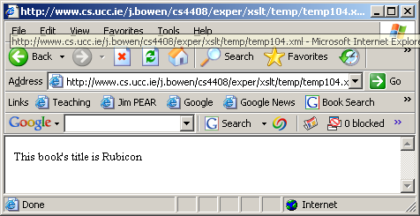
Compound conditions
<?xml version="1.0"?>
<xsl:transform version="1.0" xmlns:xsl="http://www.w3.org/1999/XSL/Transform">
<xsl:template match="/">
<body> <xsl:apply-templates select="./catalogue/book[price>25 and price&lt;30]"/> </body>
</xsl:template>
<xsl:template match="book">
This book's title is <xsl:value-of select="./title"/>.
</xsl:template>
</xsl:transform>
Compound logic operators: and or not

Slide 11
Functions in Predicates
A wide range of functions is supported
Examples:
  last(). Returns the number of nodes in a node set.
  position(). Returns the position of the context node in the context node set (starting with 1).
  current(). Returns the current node – this is usually, but not always, the same as the context node.
  count(node-set). Returns the number of nodes in a node set. Omitting node-set makes this function use the context node.
  id(string ID). Returns a node set containing the element whose ID matches the string passed to the function, or an empty node set if no element has the specified ID. You can list multiple IDs separated by white space, and this function returns a node set of the elements with those IDs.
  local-name(node-set). Returns the local name of the first node in the node set. Omitting node-set makes this function use the context node.
  namespace-uri(node-set). Returns the URI of the namespace of the first node in the node set. Omitting node-set makes this function use the context node.
  name(node-set). Returns the full, qualified name of the first node in the node set. Omitting node-set makes this function use the context node.

Slide 12
Output Methods
<?xml version="1.0" ?>
<xsl:transform version="1.0" xmlns:xsl="http://www.w3.org/1999/XSL/Transform">
<xsl:output method="html" indent="yes" encoding="iso-8859-1" />
<xsl:template match="/">
<xsl:apply-templates select="catalogue/book/price" />
</xsl:template>
<xsl:template match="price">
<body>I found a price node</body>
</xsl:template>
</xsl:transform>

Slide 13
Output Methods
<xsl:output
method = "xml" | "html" | "text" | qname-but-not-ncname
version = nmtoken
encoding = string
omit-xml-declaration = "yes" | "no"
standalone = "yes" | "no"
doctype-public = string
doctype-system = string
cdata-section-elements = qnames
indent = "yes" | "no"
media-type = string />

